Slide 1
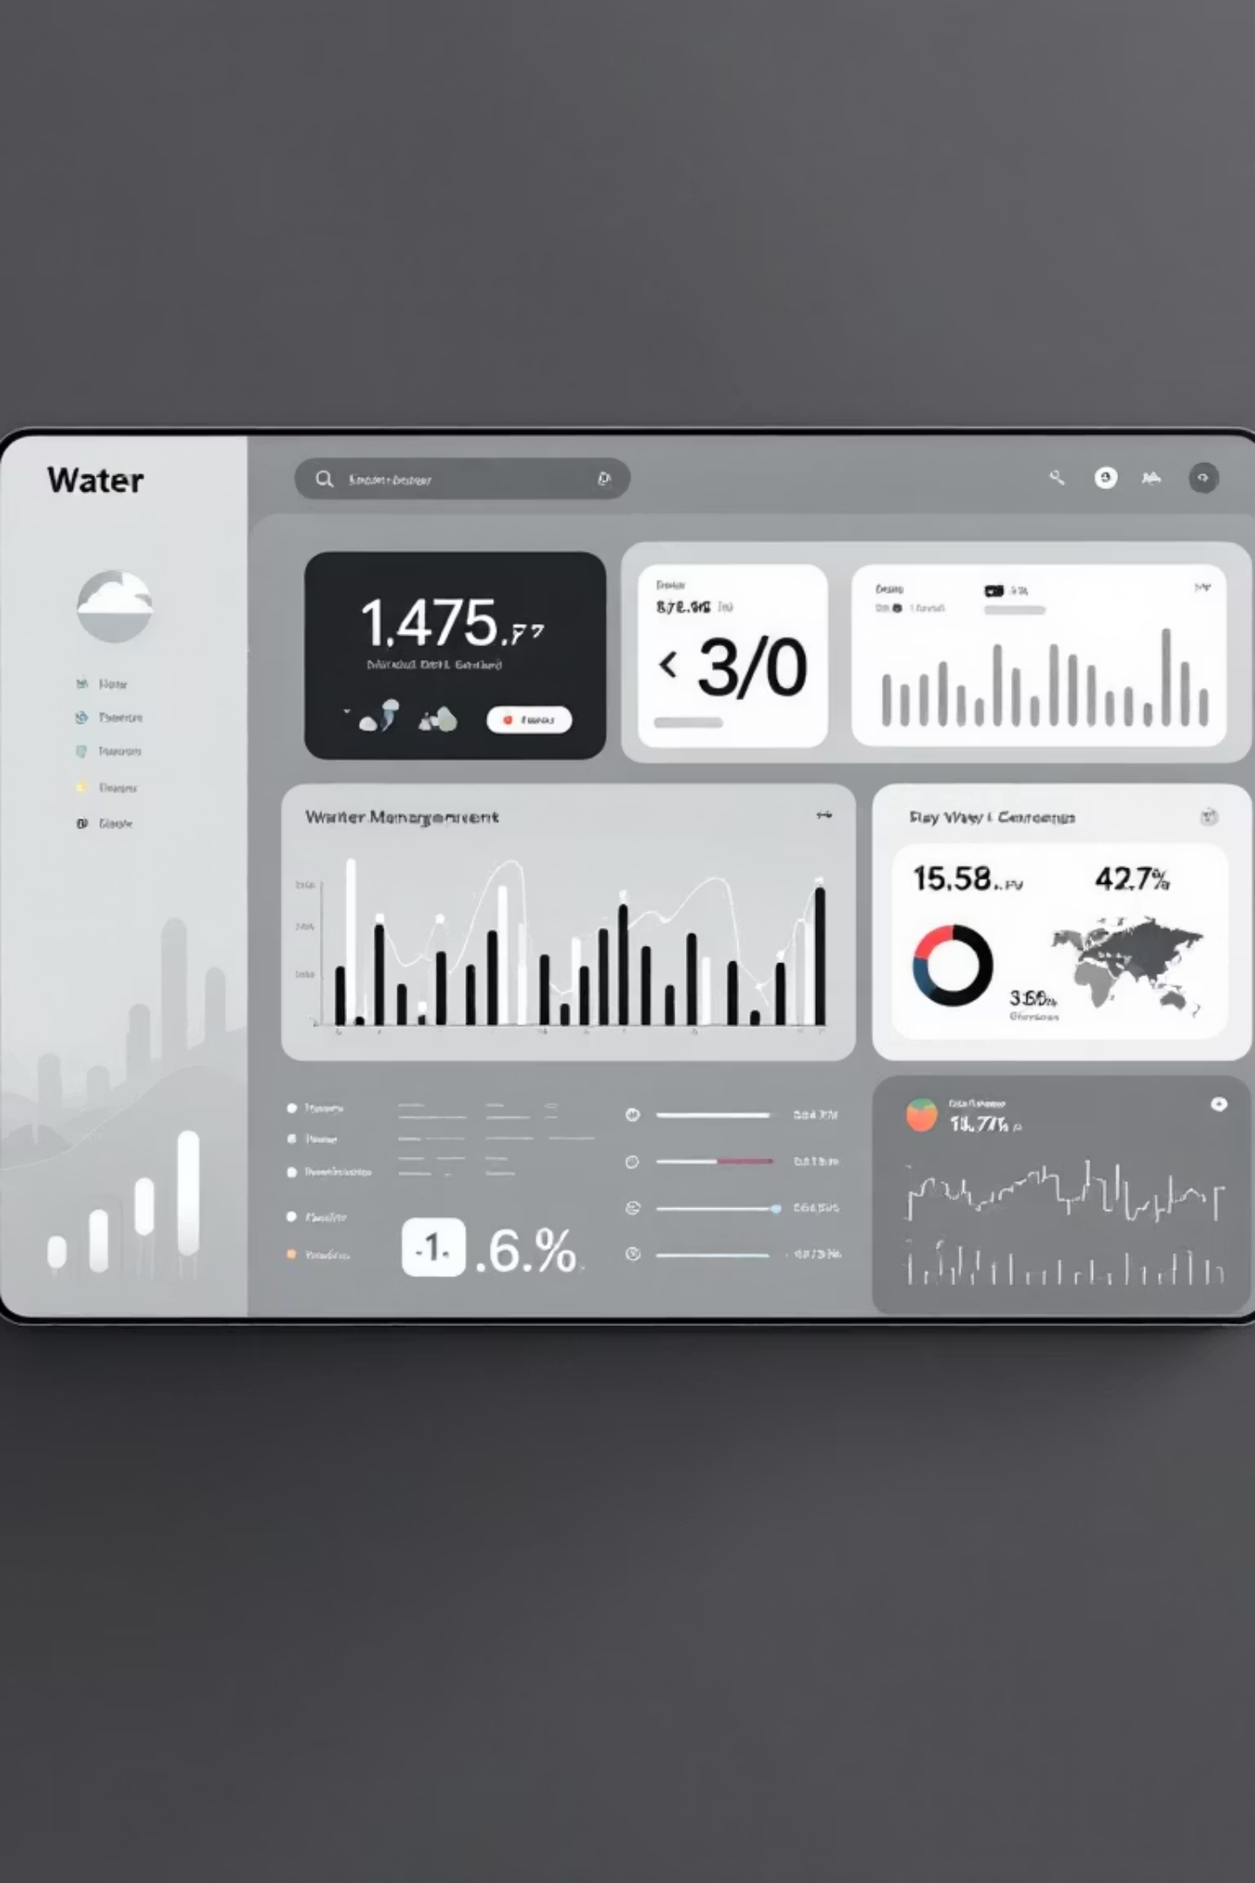
AI-Driven Navigation for Groundwater Data
Transforming complex data access into seamless user experiences through intelligent chatbot integration with the Ingres portal.

Slide 2

The Challenge: Complex Data Navigation
Information Overload
Navigation Complexity
Users struggle to locate specific groundwater data points within vast datasets, leading to inefficient workflows and delayed decision-making.
Traditional portal interfaces require extensive training and technical knowledge to access critical water management information effectively.
Language Barriers
Limited language support restricts global accessibility, preventing international stakeholders from utilizing essential groundwater resources.

Slide 3

Our Solution: Intelligent Chatbot Integration
We've developed an AI-powered chatbot that seamlessly integrates with the Ingres portal, transforming how users interact with groundwater data through natural language processing and intelligent search capabilities.
01
02
Natural Language Queries
Intelligent Search
Users can ask questions in plain English and receive precise data responses instantly.
Advanced algorithms understand user intent and locate relevant information quickly.
03
Instant Results
Real-time data retrieval with contextual explanations and visualizations.

Slide 4




Key Features Powering the Solution
Multilingual Support
Fuzzy Search Navigation
DeepTranslate integration enables seamless communication in multiple languages, breaking down barriers for global water management teams and expanding portal accessibility worldwide.
FuzzyWuzzy technology allows imprecise queries to find exact matches, accommodating typos and variations in search terms for more forgiving data discovery.
Data Comparison Tools
Condensed Data Views
Built-in comparison features enable side-by-side analysis of groundwater datasets, supporting informed decision-making through comprehensive data visualization.
Smart summarization provides essential information at a glance, reducing cognitive load while maintaining access to detailed data when needed.

Slide 5
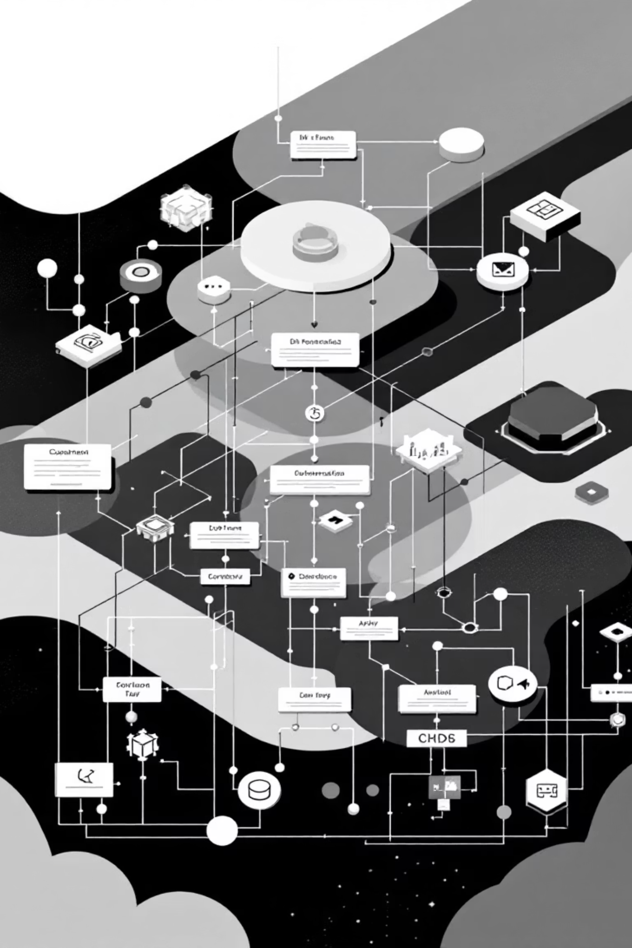
Technical Architecture
Frontend Integration
Backend Processing
Streamlit framework provides an intuitive user interface that seamlessly connects with existing Ingres portal infrastructure.
Pandas library ensures efficient data manipulation and processing for complex groundwater datasets and queries.
Responsive design
High-performance analytics
Real-time interactions
Scalable data operations
Cross-platform compatibility
Memory-efficient processing

Slide 6

Impact and Benefits
75%
90%
5x
Time Reduction
User Satisfaction
Query Accuracy
Average decrease in data search and retrieval time for technical users
Increase in successful data discoveries through fuzzy search capabilities
Improved experience ratings from water management professionals
Our solution transforms complex data navigation into an intuitive, multilingual experience that empowers water management professionals to make faster, more informed decisions.

Slide 7

Acknowledging Our Open Source Foundation
This solution is built upon the contributions of the open source community. We proudly acknowledge the technologies and libraries that made this innovation possible.
Translation & Language
Search & Discovery
DeepTranslate: Powering our multilingual capabilities with accurate, context-aware translations for global accessibility.
FuzzyWuzzy: Enabling intelligent fuzzy string matching for forgiving and flexible data queries.
Interface & Analytics
Streamlit & Pandas: Providing the framework for our user interface and robust data processing capabilities.

Slide 8

Ready to Transform Your Data Experience?
Join us in revolutionizing groundwater data management. Our AI-driven chatbot is ready to integrate with your Ingres portal, providing seamless navigation, multilingual support, and intelligent data discovery.
Schedule a Demo
Experience the power of conversational data navigation with a personalized demonstration tailored to your specific needs.
Start Integration
Begin the seamless integration process with our technical team and transform your data accessibility today.

